Slide 1
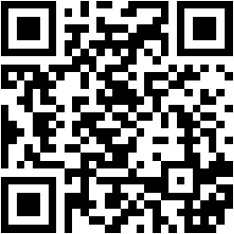



SURGICAL TECHNOLOGY EDUCATION
The AI-Enhanced Educator
Efficiency for the Surgical Tech Department
Bradly Duren, CSFA
Scan
@surgicaltechnologystc
Port Charlotte ST Department
YouTube Channel
50-Minute Interactive Session

Slide 2






SESSION AGENDA
Roadmap: The Fantastic Four + Flow
Goal: Reclaim 10+ Hours/Week
01
02
Genspark
ChatGPT
INSTANT VISUALS
THE EXECUTIVE ASSISTANT
Transform a syllabus topic into a structured slide deck in 60 seconds. Syllabus ➜ Slides
Generate detailed case plans, instrument lists, and "critical fail" points instantly. Content & Planning
03
04
Gemini Pro
NotebookLM
THE ARCHITECT
THE AUDIO REVOLUTION
Create reusable lesson codes, weekly idea blocks (bell ringers/exit tickets), and lab setups. Curriculum Structure
Turn lecture notes and PDFs into "Deep Dive" podcasts for commuting students. Passive Study Tools
Digital Lab
Canvas Masterclass
Result: High-Impact Efficiency
YouTube Program Markings
Test Banks & Modules

Slide 3




A Quick Poll
Before we begin, let's check the pulse of the room.
STEP 1
STEP 2
Raise Your Hand
Keep It Up
If you spent more than 5 hours this past weekend grading, building slides, or organizing lab setups.
ONLY if you feel like you are honestly "ahead" of your curriculum right now.
TODAY'S GOAL
We aren't here to replace you. We're here to give you your weekends back.

Slide 4
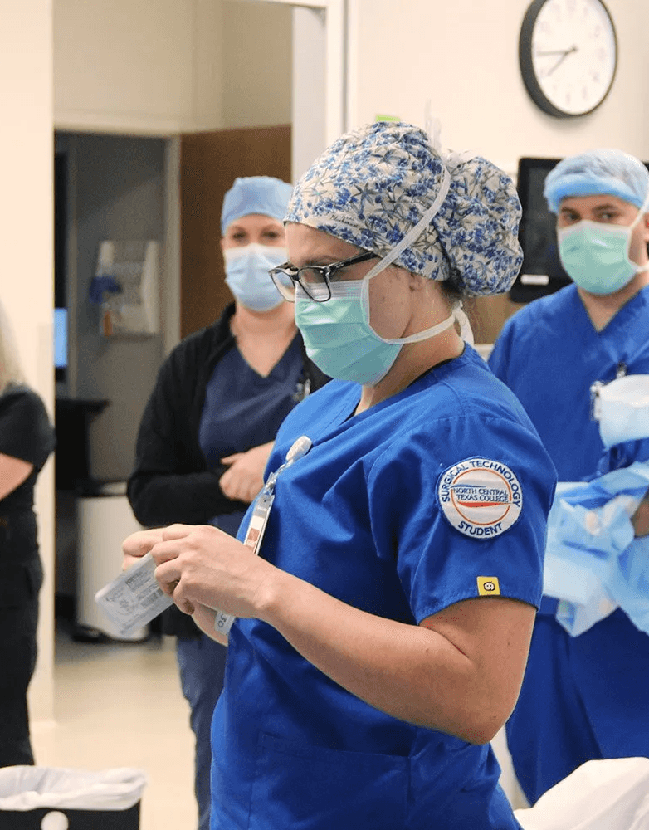



CURRENT REALITY
The Education Time Drain
Where are your weekends actually going?
Content Creation
Hours spent formatting slides, finding images, and typing syllabus topics from scratch.
Manual Administration
Tedious data entry for test banks, grading, and organizing LMS modules.
The Cost of "Busy Work"
Every hour spent on admin is an hour lost in the lab. Our goal is to shift the balance back to high-touch teaching.
Repetitive Instruction
Re-explaining the same complex lab setups (like Total Joints) individually to 20 students.
04

Slide 5





GENSPARK
From Syllabus to Slides in 60 Seconds
Transform raw topics into structured visual decks instantly.
The Efficiency Gain
1
Input Your Source
Paste your syllabus unit or type a specific topic like "Aseptic Technique".
Minutes, Not Hours
Shrink a 2-hour PowerPoint build into a 5-minute review task.
AI Generation
2
Genspark builds a structured deck with defined sections, headers, and bullet points automatically.
Professional Structure
Get clean layouts and logical flow without fighting with text boxes.
Visual Consistency
Refine & Customize
Maintain a cohesive look across all your lecture materials.
3
Add specific lab photos, tweak the flow, and export directly to PowerPoint (PPTX).
"It’s not about replacing you; it’s about starting at the finish line."

Slide 6






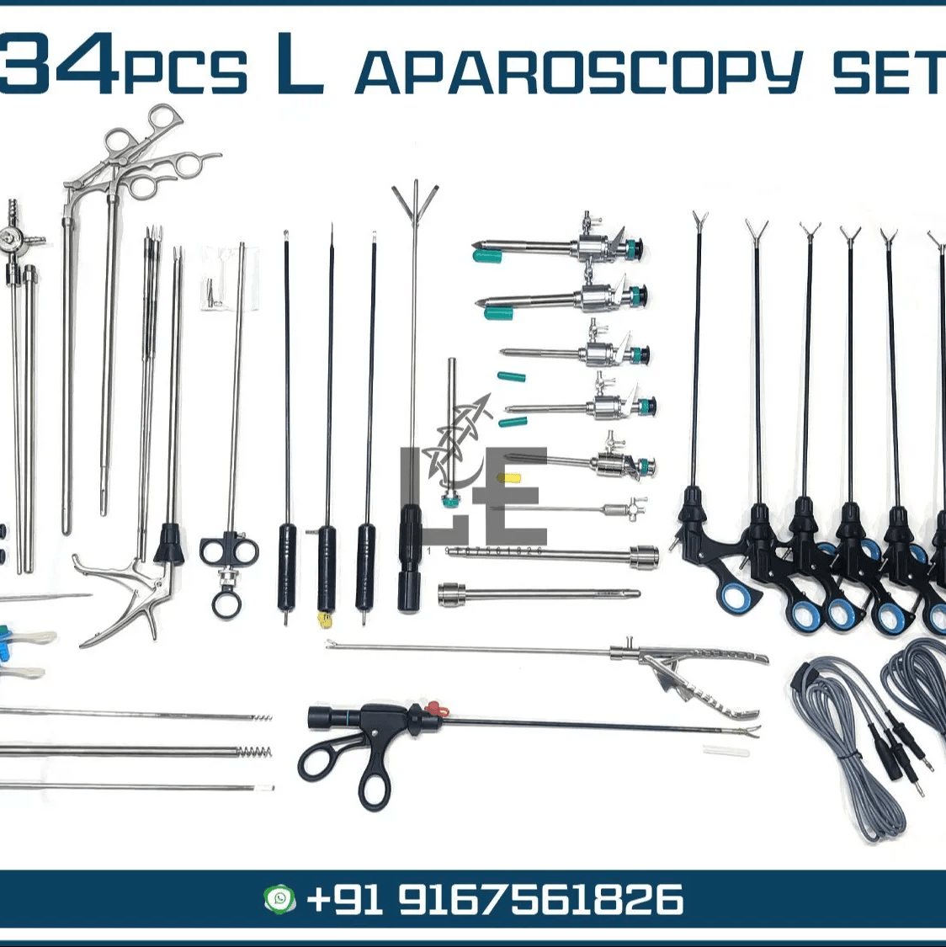

CHATGPT
The Executive Assistant
Don't just ask for text. Ask for structured plans.
INPUT (PROMPT)
OUTPUT (INSTANT PLAN)
New Chat
Case Plan: Lap Chole
Generated in 4s
"Create a surgical case plan for a Laparoscopic Cholecystectomy. Include: 1. List of Instrumentation 2. Sequence of Drapes 3. Three 'Critical Fail' points for a student."
INSTRUMENTATION
Laparoscopic Tower & 30-degree Scope
Veress Needle / Hasson Trocar
Laparoscopic Grasper & Maryland Dissector
Clip Applier & Hook Scissors
DRAPING SEQUENCE
4 Towels (Square off umbilicus)
Laparotomy Drape (Fenestrated)
Secure cords/tubing with non-perforating clamp
Student Critical Fails
1. Contaminating camera head while draping.
2. Failing to zero-balance white light before insertion.
3. Passing Veress needle without verifying spring action.

Slide 7


GEMINI PRO
Reusable Lesson-Plan Codes
"Build the structure once, use it forever."
YOUR PROMPT TEMPLATE
"Create a detailed lesson plan for [TOPIC: Surgical Pharmacology] aligned to AST Core Curriculum standards. Structure must include: 1. Learning Objectives (Bloom's Taxonomy) 2. Required Equipment/Instrumentation 3. 5-Day Pacing Guide (Mon-Fri) 4. Formative Assessment Strategy"
1
Define the "Architecture"
Don't just ask for a lesson plan. Define the explicit sections you need: Objectives, Standards, Materials, Procedure, Assessment, & Remediation.
2
Request Weekly Blocks
Weekly Unit Plan: Pharmacology
Generated by Gemini Pro
Ask Gemini to break the unit down into a Mon-Fri pacing guide with estimated time blocks for each activity.
Monday: Intro
Tuesday: Lab
Define pharmacokinetics
Safe medication transfer
Activity: Drug math worksheet
Activity: Syringe labeling drill
Time: 50 mins
Time: 90 mins
3
The "Swap" Variable
Once you have a perfect prompt structure (your "Code"), simply swap the topic. Change "Sterilization" to "Microbiology" and hit enter.
Assessment
Mock medication pass-off with rubric.
07

Slide 8







GEMINI PRO
Weekly Ideas & Micro-Learning
Generate high-impact engagement tools in seconds.
THE PROMPT
Bell Ringers
Exit Tickets
Input to Gemini:
Start class fast. 2-3 minute retrieval practice questions to wake up the room immediately.
Check understanding before they leave. 1-2 key questions to verify concept retention.
"Generate 5 bell ringers and 5 exit tickets for
Active Recall
Assessment
Surgical Pharmacology
. Align them to CST exam objectives."
Tip: Be specific about the topic and the "Critical Fail" criteria.
GENERATES
Micro-Skills
Clinical Tie-ins
Rapid-fire drills for specific technical skills: Instrument Identification, Suture Sizing, Needle Loading.
Contextualize the theory. Generate case vignettes and "What if?" scenarios for discussion.
Skill Building
Real World
08

Slide 9
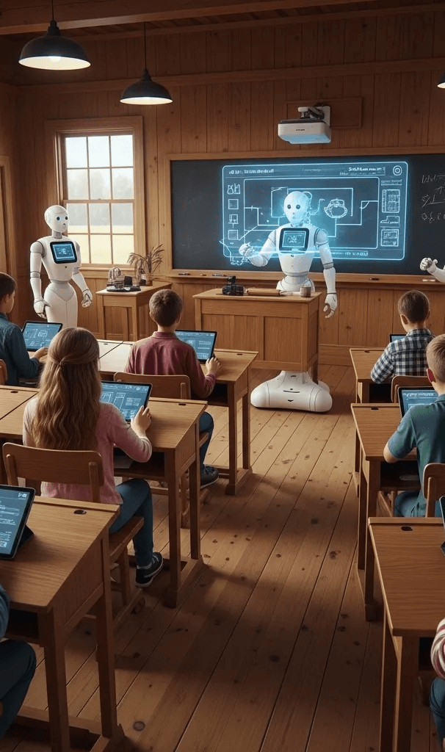





PHILOSOPHY
The "Hidden Figures" Moment
Like Dorothy Vaughan facing the IBM mainframe, we must learn the language of the machine to guide it.
Knowledge is Power
Don't fear the tech. Learn "Prompt Engineering" just as she learned FORTRAN.
Human Verification
The machine is fast, not smart. We verify accuracy for safety and ethics.
Then: The IBM Mainframe
Now: The AI Assistant
Lifting Others Up
Teach your team. Share your markings and methods to elevate the whole department.
09

Slide 10









Human Guide Philosophy: 3 Pillars
"The machine is fast, but we provide the wisdom."
01
02
03
KNOWLEDGE IS POWER
HUMAN VERIFICATION
LIFTING OTHERS UP
Learn the Language: Don't fear the tech. Master "Prompt Engineering" to control the output.
Accuracy Check: Like Katherine Johnson, verify every AI calculation and medical fact.
Share the Wealth: Use Program Markings and YouTube to guide peers and students.
Build Codes: Create reusable templates (like Gemini Pro plans) that work for you.
Safety First: Ensure AI-generated lab checklists meet strict surgical safety standards.
Lead the Way: Be the guide who teaches others to use these tools ethically.
10

Slide 11








ASSIGNMENTS & ASSESSMENT
Weekly Check-Ins & Homework
Tool: Gemini Pro + Formative Workflow
Weekly Student Workflow:
Teacher Prompt (Gemini Pro)
Weekly Planning
Week 5: Hernia Repairs
User: "Create a weekly assignment plan for 'Hernia Repair'. Include 3 specific lab skills to check off, 2 homework options (one creative, one analytical), and a self-study prompt for students to use with ChatGPT."
In-Lab Assessment & Home Study Plan
IN-LAB CHECK-IN (LIVE)
AI-ASSISTED REVIEW
Setup Inguinal Hernia Tray (Timeds)
SELF-QUIZ PROMPT
"Act as a preceptor. Quiz me on the steps of an Inguinal Hernia repair. Correct me if I miss a step."
Identify mesh types & suture selection
Demonstrate Count Protocol
HOMEWORK MENU
DUE DATES
Option A: Case Study Analysis
Wed: Lab Skills Sign-off
Option B: Create 5 Quiz Questions
Fri: Canvas Quiz + Reflection
Visual Context
Lab & Study Integration
Formative Assessment
Student Choice
Skills Tracking

Slide 12








AUDIO TOOLS
The Audio Revolution: NotebookLM
The Commuter Classroom for busy students.
Generated by NotebookLM
THE STRUGGLE
"My students are driving to clinicals, working, and exhausted. They don't have time to sit and read."
Upload Source
Drop in a 50-page CST review PDF or lecture notes.
CST Review: Microbiology
AI "Deep Dive"
NotebookLM generates a 2-voice conversational podcast.
Episode 1 • Surgical Technology Dept.
04:12
12:45
Mobile Study
Students listen & learn on their commute to the OR.
10

Slide 13

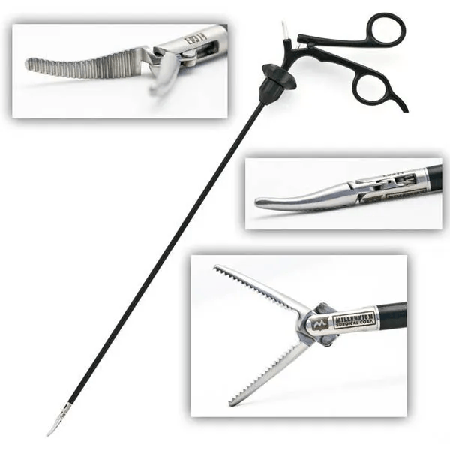

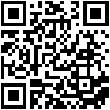




DIGITAL LAB
Connecting the Virtual to Physical
"Record once. Explain forever."
Film the Setup
Don't explain it 20 times. Record the complex tray setup one time perfectly.
BACK TABLE
SETUP
Post & Generate
Upload to @surgicaltechnologystc and copy the video URL.
The "Quick Code"
Use AI to generate a QR code. Print it and physically tape it to the equipment or tray.
MAYO STAND
SEQUENCE
Just-in-Time Learning
Students scan the station markings to see the demo instantly, even if you are across the room.
11
Total Joint Setup
@surgicaltechnologystc

Slide 14







LMS OPTIMIZATION
Canvas Masterclass: Modules & Test Banks
Stop manual data entry. Start automating your assessments.
Module Styling
The 10-Minute Test Builder
GAME CHANGER
Workflow: Text to Exam
Use "Quick Codes" to transform boring text links into visual buttons.
<div class="btn-surgical">
<a href="/module/1">
Start Lab Unit 1
</a>
ChatGPT
QTI Converter
Canvas LMS
</div>
Generate MCQs in AIKEN Format
Transform Text to Canvas File
Direct Upload to Quizzes
STUDENT VIEW
< 10 min
Start Lab Unit 1
Total Time Saved
Vs. manual typing (2+ hours)
FOR FULL EXAM
12

Slide 15









BEST PRACTICES
Safety, Accuracy & Ethics
"Trust, but verify."
Zero Tolerance for PHI
Verify & Cite
Never input real patient names, MRNs, or specific dates into public AI models. HIPAA still applies.
AI can "hallucinate" facts. Always cross-reference generated content with your textbooks/AST standards.
Respect FERPA
Check for Bias
Do not paste student essays or grade data with identifiable information into AI tools.
Medical datasets can be biased. Ensure generated case studies represent diverse patient populations.
Human in the Loop
AI is an engine, not a pilot. You hold the license, the expertise, and the responsibility.
Student Transparency
You Make the Call
Be clear about how AI is used in class and what the rules are for student use.
Use AI to remove friction, not critical thinking. You are the final editor of all content.
13

Slide 16

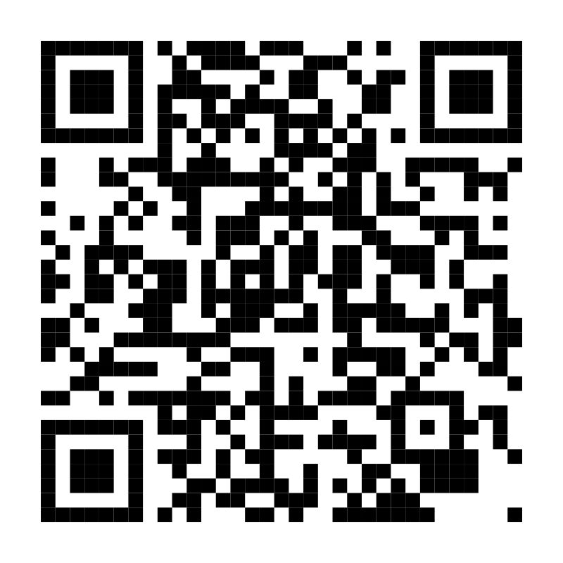





Your Turn: The Challenge
"AI is a tool to remove the friction of teaching."
Pick One For This Week:
SCAN FOR RESOURCES
Create a NotebookLM Podcast
Upload one difficult chapter PDF and share the audio.
Build a Deck with Genspark
Turn your syllabus into a visual slide deck in minutes.
Generate a Gemini Lesson Code
@surgicaltechnologystc
Create one reusable prompt for your weekly planning.
RESOURCES INCLUDED:
Lab Markings
Video Demos
Prompt Examples
Q&A Session
Presenter: Bradly Duren, CSFA
What questions do you have for me?

